Slide 1
HTML
Course Code: CSC 3215
Course Title: WEB TECHNOLOGIES
Dept. of Computer Science
Faculty of Science and Technology
Lecturer No: | 2 | Week No: | 2 | Semester:
Lecturer: | Md.Al-Amin (alamin@aiub.edu)

Slide 2
What is HTML?
HTML stands for Hyper Text Markup Language
HTML describes the structure of a Web page
HTML consists of a series of elements
HTML elements tell the browser how to display the content
HTML elements are represented by tags
HTML tags label pieces of content such as ”heading”, ”paragraph”, ”table”, and so on
Browsers do not display the HTML tags, but use them to render the content of the page
The first version of HTML was written by Tim Berners-Lee in 1993

Slide 3
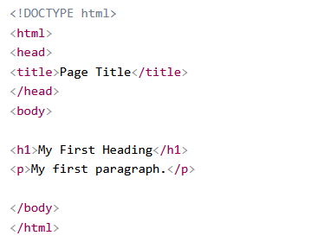
HTML Tags and Example
HTML tags are element names surrounded by angle brackets:
<tagname>content goes here...</tagname>

Slide 4
HTML Documents = Web Pages
HTML documents describe web pages
HTML documents contain HTML tags and plain text
HTML documents are also called web pages
e.g.
<html> <body> <h1>My First Heading</h1> <p>My first paragraph.</p> </body> </html>

Slide 5
HTML Version
Type of content | HTML 1.2 | HTML 4.01 | HTML5 | Purpose
Heading | Yes | Yes | Yes | Organize page content by adding headings and subheadings to the top of each section of the page
Paragraph | Yes | Yes | Yes | Identify paragraphs of text
Address | Yes | Yes | Yes | Identify a block of text that contains contact information
Anchor | Yes | Yes | Yes | Link to other web content
List | Yes | Yes | Yes | Organize items into a list
Image | Yes | Yes | Yes | Embed a photograph or drawing into a web page
Table | No | Yes | Yes | Organize data into rows and columns
Style | No | Yes | Yes | Add CSS to control how objects on a web page are presented
Script | No | Yes | Yes | Add Javascript to make pages respond to user behaviors (more interactive)
Audio | No | No | Yes | Add audio to a web page with a single tag
Video | No | No | Yes | Add video to a web page with a single tag
Canvas | No | No | Yes | Add an invisible drawing pad to a web page, on which you can add drawings (animations, games, and other interactive features) using Javascript

Slide 6
HTML Tags and Elements
An HTML element usually consists of a start tag and an end tag, with the content inserted in between.
Please explore all Elements from https://www.w3schools.com/ one by one.
https://www.w3schools.com/tags/default.asp
Start tag | Element content | End tag
<h1> | My First Heading | </h1>
<p> | My first paragraph. | </p>
<br>

Slide 7
HTML Attributes
All HTML elements can have attributes
Attributes provide additional information about an element
Attributes are always specified in the start tag
Attributes usually come in name/value pairs like: name="value“
Example : HTML links are defined with the <a> tag. The link address is specified in the href attribute.
<a href="https://www.aiub.edu">AIUB</a>
<img src="img_girl.jpg">
Please explore all Elements/ Tags/ attributes from https://www.w3schools.com/tags/ref_attributes.asp

Slide 8
Popular HTML Elements
1. Favicon
A small icon displayed in the browser tab or bookmark. Added using the <link> tag in the <head> section:
<head><link rel="icon" type="image/x-icon" href="favicon.ico"></head>
2. Page Title
The title of the webpage displayed in the browser tab or window. Defined using the <title> tag within the <head> section.
<head><title>My Webpage Title</title></head>
3. HTML Head
The <head> section contains metadata and links to external resources.
<head>
<title>Page Title</title>
<meta charset="UTF-8">
<meta name="description" content="Page Description">
<link rel="stylesheet" href="styles.css">
</head>

Slide 9
HTML Table
Table
Used to display data in rows and columns.
<table>
<tr>
<th>Header 1</th>
<th>Header 2</th>
</tr>
<tr>
<td>Data 1</td>
<td>Data 2</td>
</tr>
</table>
Tags: <table>, <tr> (table row), <th> (table header), <td> (table data).

Slide 10
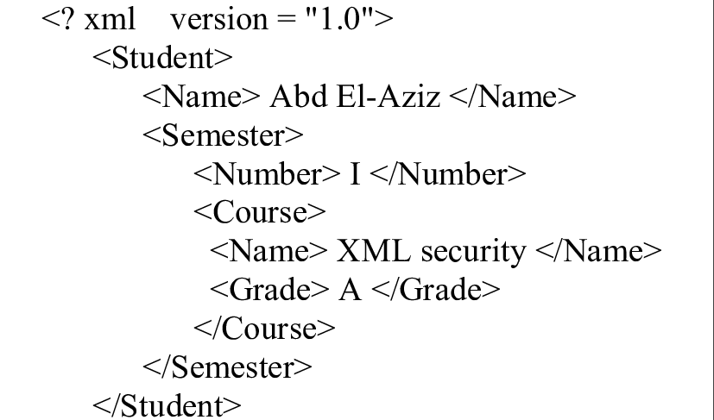
XML
XML stands for eXtensible Markup Language.
XML was designed to store and transport data.
XML was designed to be both human- and machine-readable.

Slide 11
What is XML?
XML was designed to carry data, not to display data
XML tags are not predefined. You must define your own tags
XML is designed to be self-descriptive
XML is a W3C Recommendation
Maybe it is a little hard to understand, but XML does not DO anything. XML was created to structure, store, and transport information.
XML is the most common tool for data transmissions between all sorts of applications.

Slide 12
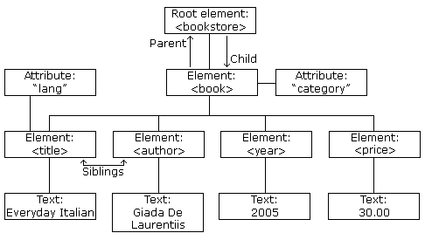
XML Documents Form a Tree Structure
XML documents must contain a root element. This element is "the parent" of all other elements.
The elements in an XML document form a document tree.

Slide 13
XML Naming Rules
XML elements must follow these naming rules:
Names can contain letters, numbers, and other characters
Names cannot start with a number or punctuation character
Names cannot start with the letters xml (or XML, or Xml, etc)
Names cannot contain spaces
Any name can be used, no words are reserved.
XML Syntax
All XML Elements Must Have a Closing Tag
XML Tags are Case Sensitive
XML Elements Must be Properly Nested
XML Documents Must Have a Root Element
XML Attribute Values Must be Quoted

Slide 14
What is the DOM?
a standard for accessing documents like XML and HTML
"The W3C Document Object Model (DOM) is a platform and language-neutral interface that allows programs and scripts to dynamically access and update the content, structure, and style of a document."
The DOM is separated into 3 different parts / levels:
Core DOM - standard model for any structured document
XML DOM - standard model for XML documents
HTML DOM - standard model for HTML documents
The DOM defines the objects and properties of all document elements, and the methods (interface) to access them.

Slide 15
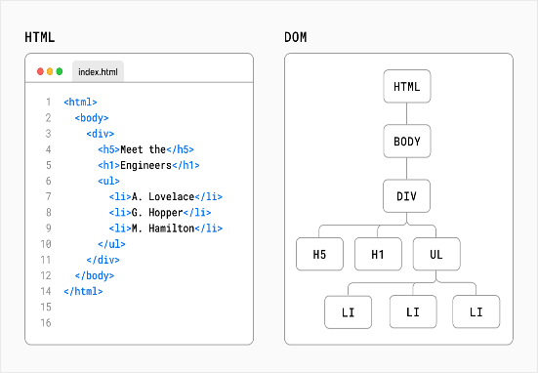
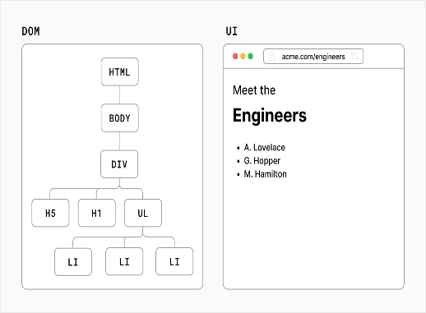
DOM application and Example
When an HTML page is rendered in a browser, the browser parses the markup (e.g. HTML), downloaded from the web-server into an in-memory DOM.
The DOM is used to construct additional internal structures used to display the page in the browser window.

